Slide 1
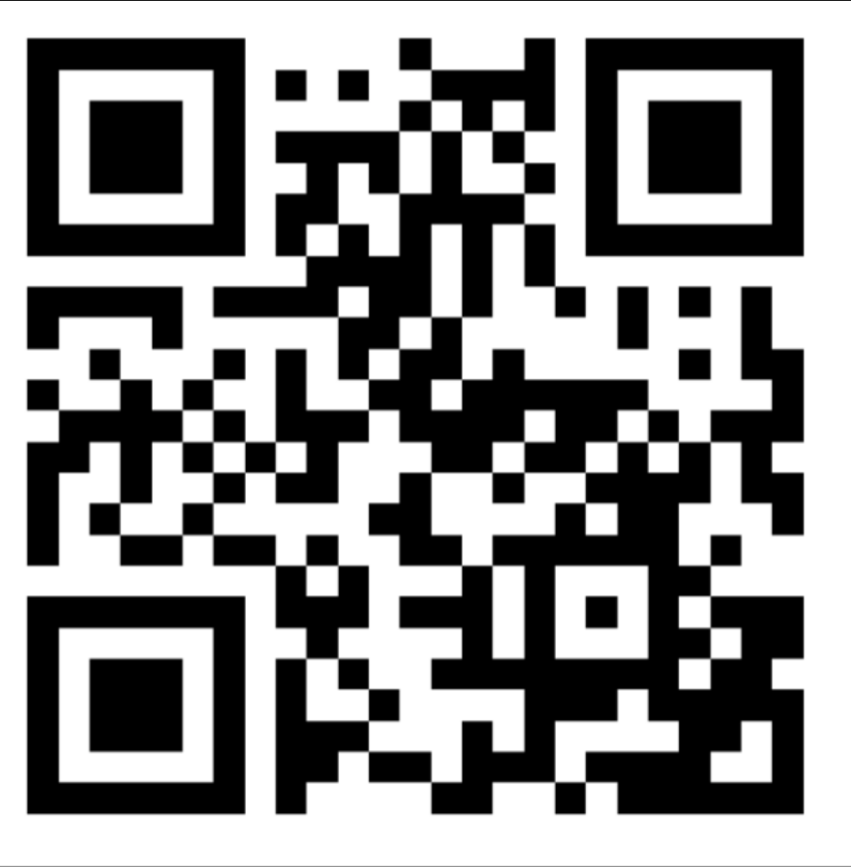
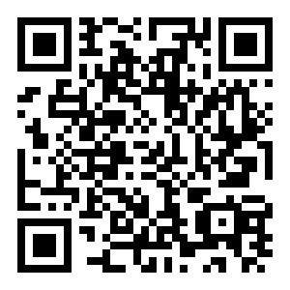

Welcome to GAI
Discord
RSVP for next meeting
Instagram
Project Day 1
https://z.umn.edu/gai-project2

Slide 2
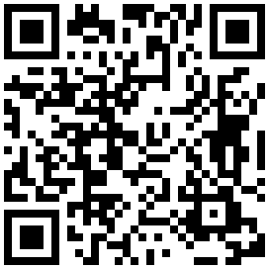
Announcement
Looking for new officers, anyone interested in leading the club next year!
Fill out this interest form (https://z.umn.edu/officer-interest)
Feel free to contact us with the club email (gai@umn.edu) or on discord, or just talk to us in person!

Slide 3
Project Overview
Begin to automate job application + other cool browser stuff using LLMs

Slide 4
Environment Setup

Slide 5
Installing Dependencies
VS Code (this is the code editor I will be using, feel free to use whatever you are used to)
https://code.visualstudio.com/
Check “Add to PATH” during installation
Create a folder that we will be working in and open that up in VS Code

Slide 6
Installing Dependencies
Installing uv
https://docs.astral.sh/uv/getting-started/installation/
Installing browser-use and other libraries
https://docs.browser-use.com/quickstart
Installing chromium browser to use
sudo apt install chromium-browser

Slide 7
Setting Up Environment
Create a .env file, this is where we will place our OPENAI_API_KEY
OPENAI_API_KEY=”your-api-key-here”
Copy and paste the key you have from your Google Colab notebooks, or create a new one if you cannot find your old key

Slide 8
Food and socialize
Come talk to me if you don’t have an API key set up yet, or if you have difficulties setting up your environment

Slide 9
Let’s get started!!

Slide 10
Code we’ll be using/modifying
https://z.umn.edu/gai-project1-code

Slide 11
THANK YOU!

Slide 12
RSVP for Next Meeting
https://z.umn.edu/gai-project2

